Slide 1
Chapter Four
Advanced Topics

Slide 2
Object-Oriented Programming Basics
Object-oriented Programming (OOP): A methodology of programming that uses object and class concepts in programming, and new types of objects are defined
Major principles of object-oriented programming is given below:
Object, Class, Method, Inheritance ,Polymorphism , Data Abstraction , Encapsulation
Object or Instance:
A single unit that combines attributes and methods
Object is an entity that has state and behavior
Attribute or field: A "characteristic" of an object; like a variable associated with a kind of object
Method or Message - A "behavior" of an object; like a function associated with a kind of object
Class :A collection of objects.
It is a logical entity that has some specific attributes and methods
Inheritance :It specifies that one object acquires all the properties and behaviors of parent object.

Slide 3
Object-Oriented Programming Basics
Polymorphism: It defines that one task can be performed in different ways.
Encapsulation: used to restrict access to methods and variables.
In encapsulation, code and data are wrapped together within a single unit from being modified by accident
Data Abstraction:
Abstraction is used to hide internal details and show only functionalities.
Data abstraction is achieved through encapsulation.
Abstracting give names to things, so that the name captures the core of what a function or a whole program does

Slide 4

Object-Oriented Programming Basics
Class: A class is code that specifies the data attributes and methods for a particular type of object.
Think of a class as a “blueprint” from which objects may be created. It serves a similar purpose as the blueprint for a house. The blueprint itself is not a house, but is a detailed description of a house.
Class Definitions A class definition is a set of statements that define a class’s methods and data attributes.
To create a class, use the keyword class: class ClassName : <statement -1> . . . <statement-N>
Output:
class Employee:
emid='em100'
name='Abebe'
e=Employee()
print(e.emid)
print(e.name)
class Employee:
emid=''
name=''
e=Employee()
e.emid='em100'
e.name='Abebe'
print(e.emid+" "+e.name)

Slide 5
Object-Oriented Programming Basics
In python, Each class method should have an argument self as its first argument. This object is a self-reference
Some class method names have special meaning, for example: – __init()__:
- In Python all classes have a built-in function called init () , which is always invoked when the object is first created.
-In many other OOP languages we call this the Constructor.
– __str()__ : A method that is invoked when a simple string representation of the class is needed, as for example when printed. – There are many more, see http://docs.python.org/2/reference/datamodel.html#specialmethod-names

Slide 6

Object-Oriented Programming Basics
class Employee: def __init__(self,emid,name): self.emid=emid self.name=name e=Employee('em100','Abebe') print(e.emid+" "+e.name) Output:
class Employee:
def __init__(self,emid,name):
self.emid=emid
self.name=nam
def display(self):
print(self.emid)
print(self.name)
e=Employee('em100','Abebe')
e.display()

Slide 7
Working with Instances
Object-Oriented Programming Basics
Each instance of a class has its own set of data attributes
When a method uses the self parameter to create an attribute, the attribute belongs to the specific object that self references. We call these attributes instance attributes because they belong to a specific instance of the class.
It is possible to create many instances of the same class in a program.

Slide 8
Example
Object-Oriented Programming Basics
emp.py class Employee: def __init__(self,empid,name): self.empid=empid self.name=name def display(self): print(self.empid+" "+ self.name) | testemp.py from emp import Employee emp1=Employee("emp100","Abebe") emp1.display() emp2=Employee("emp101","Amira") emp2.display() Output: emp100 Abebe Emp101 Amira

Slide 9

Inheritance
Object-Oriented Programming Basics
Inheritance allows to create anew class (Child Class) from the existing class (Parent Class).
The child class inherits all the attributes of its parent class.
Parent class is the class, whose properties are being inherited by subclass. Parent class is also called as Base class or Super Class.
Child class is the class that inherits properties from another class. The child class is also called as Sub class or Derived Class.
class Person: def __init__(self, fname,lname) : self.fname=fname self.lname=lname def displayinfo(self): print(self.fname," ",self.lname) p=Person("Mike","Jone") p.displayinfo() | class Student(Person): pass # does not wish to add any other properties or #methods to the derived class stud=Student("Mahlet","Tesfaye") stud.displayinfo() Output:

Slide 10

Object-Oriented Programming Basics
class Person:
def __init__(self,fname,lname,address):
self.fname=fname
self.lname=lname
self.address=address
def displaydata(self):
print(self.fname," ",self.lname," ",self.address)
p=Person("Selam","Kebede","Debre Berhan")
p.displaydata()
class Student(Person):
def __init__(self, fname, lname, address,col):
Person.__init__(self,fname, lname, address)
self.College=col
def Greeting(self):
print(self.fname," ",self.lname,"",self.address,"",self.College)
st=Student("Salim","Amar","Addis Ababa","computing")
st.displaydata()
st.Greeting()
we can reuse an existing class and inherit all the capabilities of an existing class and then add our own little bit to make our new class

Slide 11
Graphical User Interface (GUI) Programming
Graphical User Interface Programming
A GUI is an interface that enables a user to interact with a computer program or an electronic device through visual indications and graphical elements (also called objects or controls) such as a click button, checkbox, textbox, drop-down menu, scrollbar, etc.
Prior to the invention of GUIs, interaction with a computer was by text-based commands whereby a user would type instructions into a command line.
But, a GUI provides a computer environment that is simple and easy to use.
A well-designed GUI will enable a non-expert user to navigate through the system with ease, and the user does not have to know or memorize any special codes or commands.
All user interaction with the GUI is through a human interface device such as a keyboard, mouse, touchscreen etc.

Slide 12
Graphical User Interface Programming
Python GUIs are built from modules (or function libraries) that ship with Python or may be downloaded for free.
Some of the more popular packages include:
tkinter : This is an interface to the tk GUI toolkit that ships with Python.
wxPython : This is an open-source interface for wxWindows.
JPython : This is a port for Java which gives scripts written in Python seamless access to the Java GUI capabilities on your local machine

Slide 13
Python tkinter
Graphical User Interface Programming
Python does not have GUI programming features built into the language itself
However, it comes with a module named tkinter that allows you to create GUI programs
tkinter (pronounced tee-kay-inter) is a built-in module that contains functions and methods for creating Python GUIs.
The name tkinter is short for “tk interface”, the interface to the tk GUI tools
The general steps to create a Python GUI using tkinter are as follows:
import the tkinter module
create the main window of the GUI
add objects (or controls) - click button, checkboxes, labels etc., to the main window of the GUI, as needed
insert the code for the main window into a loop that keeps the main window up and available

Slide 14
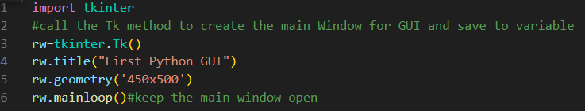
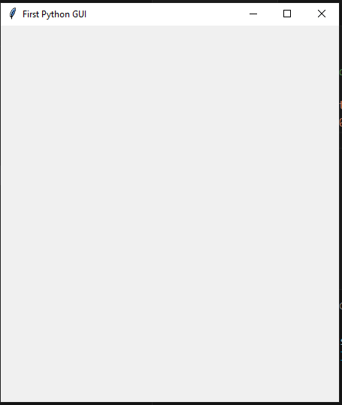
Example
Graphical User Interface Programming
The mainloop( ) method “reopens” the window continuously, obviously at speeds faster than the human eye can perceive, and this continues infinitely or until the user clicks on the “X” on the window to terminate the mainloop( )

Slide 15
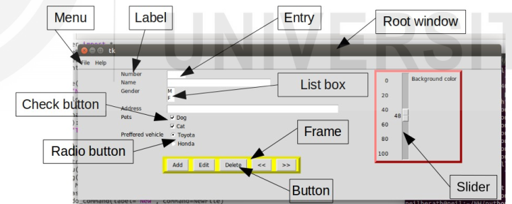
Graphical User Interface Programming
A python tkinter module provides various graphical widgets with which the user can interact or view. In Python, a control (or object) is called a widget.

Slide 16
THE LABEL WIDGET
Graphical User Interface Programming
The Label widget is used to display a single line of text.
A label is used for display, thus a user does not interact with it.
The syntax is of the form, < variable > = Label ( < master > , < option > = < value > , < option > = < value > , … ) where < variable > is a variable name that the widget is assigned to < master > is the name of the variable the main GUI window has been assigned to, or the full reference to the main window < option > is an attribute < value > is the specific value of the attribute
The widget options are summarized below:

Slide 17
widget options
Graphical User Interface Programming
Option | Description | Values
text | displays one or more lines of text line breaks | set key to the text string with line breaks
height | sets the vertical dimension of the widget
background or bg | background color of the widget | default depends on the operating system
foreground or fg | controls the text color | default depends on the operating system
bitmap | used to display an image | assign image object to the bitmap key
font | controls the text font | default depends on the operating system
image | used to display an image in the widget | set option key to image object

Slide 18
Layout Management
Graphical User Interface Programming
All tkinter widgets can be arranged and managed on a master (or parent) widget by using any of the three (3) layout (or geometry) management methods (or layout manager).
A layout manager must be used exclusively and shall not intermixed with another layout manager in the same master window. 1. The pack( ) Method
The pack( ) method: It organizes the widgets in blocks before placing in the parent widget The syntax is of the form, < variable > . pack( ) The following options may be passed to the pack manager.

Slide 19
pack( ) options
Graphical User Interface Programming
Option | Description | Values
side | determines which side to pack the widget against | TOP packs vertically, LEFT packs horizontally, default = TOP
expand | specifies whether the widgets should be expanded to fill any extra space in the master | default = false
ipadx | internal padding | default = 0
ipady | internal padding | default = 0
padx | external padding | default = 0
pady | external padding | default = 0

Slide 20
Graphical User Interface Programming
2. The grid( ) Method
The grid( ) method is used to arrange widgets into a 2-dimensional tabular structure.
The master widget is split into rows and columns where each cell of the table can hold a widget.
The syntax is of the form, < variable > . grid( < options > )
The options that may be passed to the grid manager are shown Next…

Slide 21
grid( ) options
Graphical User Interface Programming
Option | Description | Values
row | specifies row in which widget is inserted, row numbers start from 0 | defaults to first empty row in the grid if omitted
column | specifies column in which widget is inserted, column numbers start from 0 | if omitted, defaults to 0
columnspan | optional, used to make cell span multiple columns | default = 1
ipadx | optional, internal padding | default = 0
ipady | optional, internal padding | default = 0
padx | optional, external padding | default = 0
pady | optional, external padding | default = 0
rowspan | optional, used to make cell span multiple rows | default = 1

Slide 22
Graphical User Interface Programming
3. The place( ) Method
The place( ) method is used to explicitly set the position and size of a widget on a master, either in absolute terms or relative to another widget. The syntax is of the form, < variable > . place( < options > ) The options that may be passed to the place manager are shown Next.. Eg. positional x ,positional y

Slide 23
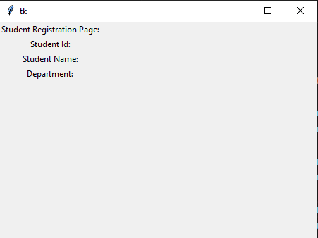
Label Widget Examples
Graphical User Interface Programming
import tkinter
rw=tkinter.Tk()
rw.geometry("450x500")
lb1=tkinter.Label(rw,text="Student Registration Page:")
lb1.grid(row=0,column=0)
lb2=tkinter.Label(rw,text="Student Id:")
lb2.grid(row=1,column=0)
lb3=tkinter.Label(rw,text="Student Name:")
lb3.grid(row=2,column=0)
lb4=tkinter.Label(rw,text="Department:")
lb4.grid(row=3,column=0)
rw.mainloop()

Slide 24
THE ENTRY WIDGET
Graphical User Interface Programming
The Entry widget is used to accept a single-line text string entered by a user. The syntax is of the form, < variable > = Entry (< master > , < option > = < value > , < option > = < value > , … ) where < variable > is a variable name that the widget is assigned to < master > is the name of the variable the main GUI window has been assigned to, or the full reference to the main window < option > is an attribute < value > is the specific value of the attribute

Slide 25
THE BUTTON WIDGET and Info Dialog Boxes
Graphical User Interface Programming
The Button widget is a “click” button that is clicked on to trigger some event. Typically, a function or a method (or some combination of both) is incorporated into the code structure of the Button. The function (or method) is assigned to the command option. The function (or method) is called when the Button is clicked on. The syntax is of the form, < variable > = Button ( < master > , < option > = < value > , < option > = < value > , … ) where < variable > is a variable name that the widget is assigned to < master > is the name of the variable the main GUI window has been assigned to, or the full reference to the main window < option > is an attribute < value > is the specific value of the attribute

Slide 26
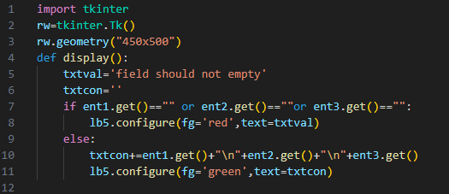
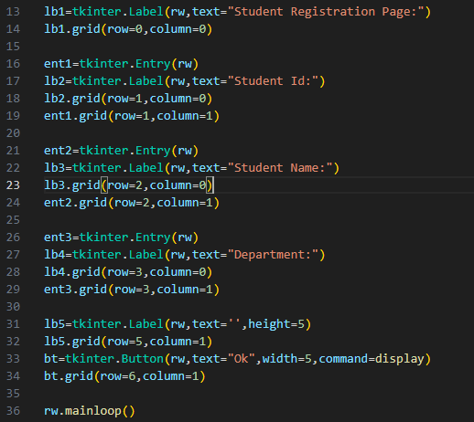
Example
Graphical User Interface Programming

Slide 27
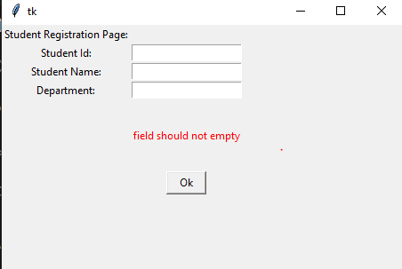
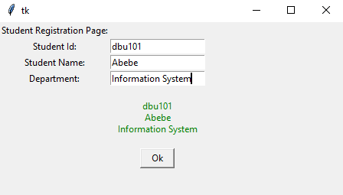
Sample Output
Graphical User Interface Programming

Slide 28
info dialog box
Graphical User Interface Programming
An info dialog box is a simple window that displays a message to the user, and has an OK button that dismisses the dialog box.
You can use the tkinter.messagebox module’s showinfo function to display an info dialog box.
To use the showinfo function, you will need to import the tkinter.messagebox module.
The general format of the showinfo function call is: tkinter.messagebox.showinfo(title, message)

Slide 29

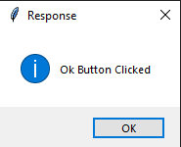
Example
Graphical User Interface Programming
import tkinter
import tkinter.messagebox
def click_Ok():
tkinter.messagebox.showinfo("Response","Ok Button Clicked")
rw=tkinter.Tk()
bt1=tkinter.Button(rw,text="Ok",background="green",fg="red",command=click_Ok)
bt1.grid(row=0,column=0)
rw.mainloop()

Slide 30
THE CHECKBUTTON WIDGET
Graphical User Interface Programming
The Checkbutton widget consists of a toggle button (check box) and the user clicks on the check box to select the option.
Multiple Checkbuttons may be used and multiple selections may be made.
A Checkbutton may be on (checked) or off (unchecked).
The syntax is of the form, < variable > = Checkbutton ( < master > , < option > = < value> , < option> = < value> , … ) where < variable > is a variable name that the widget is assigned to < master > is the name of the variable the main GUI window has been assigned to, or the full reference to the main window < option > is an attribute < value > is the specific value of the attribute

Slide 31
THE RADIOBUTTON WIDGET
Graphical User Interface Programming
The Radiobutton is also called an option button. This widget is similar to a Checkbutton, however it consists of multiple toggle button – option pairs and only one option can be selected.
It is analogous to making a selection to a multiple-choice test question. The structure of the syntax consists of several Radiobutton calls assigned to the same variable
The syntax is of the form, < var > = Radiobutton ( < master > , < option > = < value> , < option> = < value> , … ) < var > = Radiobutton ( < master > , < option > = < value> , < option> = < value> , … ) < var > = Radiobutton ( < master > , < option > = < value> , < option> = < value> , … ) : where < var > is the common variable each button is associated with < master > is the name of the variable the main GUI window has been assigned to, or the full reference to the main window < option > is an attribute < value > is the specific value of the attribute
The attributes, options and methods for Checkbuttons apply similarly to Radiobuttons

Slide 32

Example:
Graphical User Interface Programming
lb9=tkinter.Label(rw,text="Gender:")
lb9.grid(row=11,column=1)
rbtn=tkinter.Radiobutton(rw,text="Male",value=1)
rbtn.grid(row=11,column=2)
rbtn=tkinter.Radiobutton(rw,text="Female",value=2)
rbtn.grid(row=12,column=2)

Slide 33
THE FRAME WIDGET
Graphical User Interface Programming
The Frame widget is used as a container to organize and manage other widgets.
Frames can be used to “split” the widgets into groups and a group can be managed as a single unit through the Frame.
The Frame serves as the “master” for the widgets that are organized on it.
The geometry management methods can be applied to individual Frames to achieve versatile organization and display of the widgets.
The syntax is of the form,
< variable > = Frame ( < master > , < option > = < value > , < option > = < value > , … )
where
< variable > is a variable name that the widget is assigned to
< master > is the name of the variable the main GUI window has been assigned to, or the full reference to the main window
< option > is an attribute
< value > is the specific value of the attribute
A widget can then be added to the window, directly to the Frame, as follows,
< variable > = < Widget > ( < Frame > , < options > )

Slide 34
THE LISTBOX WIDGET
Graphical User Interface Programming
A Listbox widget is used to select an item(s) from the list of itemspresented. The widget has four (4) modes that govern how many items may be selected.
The lines of the items are indexed. A Listbox may be associated with a function or method which is called when the state of the widget is changed by the user.
The syntax to create the empty Listbox is of the form, < var > = Listbox ( < master > , < option > = < value> , < option> = < value> , … ) where < var > is a variable name that the widget is assigned to < master > is the name of the variable the main GUI window has been assigned to, or the full reference to the main window < option > is an attribute < value > is the specific value of the attribute
The syntax to add line items to the list by the insert method, is as of the form, < var > . insert( < index > , < item > ) < var > . insert( < index > , < item > ) < var > . insert( < index > , < item > ) : where the item is inserted before the line of the specified index

Slide 35
Listbox widget options
Graphical User Interface Programming
Option | Description | Values
selectmode | governs how many items can be selected | default = BROWSE which allows one item to be selected, SINGLE, MULTIPLE - clicking on any line toggles its selection on or off, EXTENDED – enables selection of group of adjacent items
width | width of the widget by number of characters | default = 20
xscrollcommand | enables horizontal scrolling of the Listbox
yscrollcommand | Enables vertical scrolling of the Listbox

Slide 36
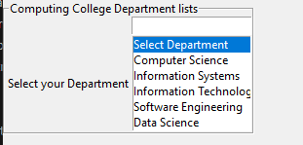
Example
Graphical User Interface Programming
lbframe3=tkinter.LabelFrame(rw,text="Computing College Department lists")
lbframe3.grid(row=7,column=0,columnspan=2)
lb7=tkinter.Listbox(lbframe3,height=6,selectmode=tkinter.SINGLE)
lb7.insert(1,'Select Department')
lb7.insert(2,"Computer Science")
lb7.insert(3,"Information Systems")
lb7.insert(4,"Information Technology")
lb7.insert(5,"Software Engineering")
lb7.insert(6,"Data Science")
lb7.selection_set(0)
lb7.grid(row=8,column=1)
lb8=tkinter.Label(lbframe3,text="Select your Department")
lb8.grid(row=8,column=0)

Slide 37
THE CANVAS WIDGET
Graphical User Interface Programming
A canvas is a widget on which sketches, diagrams etc. are drawn. Also, a canvas may hold graphics, text, Frames and other widgets
The syntax is of the form, < variable > = Canvas ( < master > , < option > = < value > , < option > = < value > , … ) where < variable > is a variable name that the widget is assigned to < master > is the name of the variable the main GUI window has been assigned to, or the full reference to the main window < option > is an attribute < value > is the specific value of the attribute

Slide 38
Drawing Objects
Graphical User Interface Programming
A summary of selected drawing objects supported by the Canvas widget is as follows.
Line The syntax to create a line is of the form, line = canvas.create_line ( x0, y0, x1, y1, x2, y2, … , xn, yn, < options > ) where the x-y pairs are the coordinates of points on the line Polygon The syntax to create a polygon is of the form, polygon = canvas.create_polygon ( x0, y0, x1, y1, x2, y2, … , xn, yn, < options > ) where the x-y pairs are the coordinates of the vertices of the polygon, and at least three (3) vertices must be specified

Slide 39
Graphical User Interface Programming
Arc The syntax to create an arc of a circle is of the form, arc = canvas.create_arc ( < coordinates > , < options > ) The options such as fill, start, extent, may be manipulated to produce an arc, a chord, or a sector of a circle.
Oval The syntax to create a circle, or an ellipse, is of the form, oval = canvas.create_oval ( < coordinates > , < options > ) where two pairs are the coordinates are required, for an ellipse the coordinates of the top left and bottom right corners of the bounding rectangle must be specified.
Image The syntax to create an image item – BitmapImage or PhotoImage, is of the form, image = canvas.create_image ( < coordinates > , < options > ) where the coordinates shall be for the insertion point of the object, and the options include filename which is set to the name of the file containing the image or the full path to the file

Slide 40
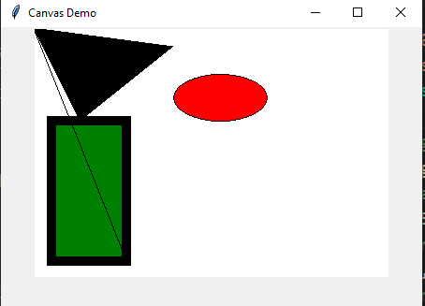
Example
Graphical User Interface Programming
import tkinter
canrw=tkinter.Tk()
canrw.geometry("450x300")
canrw.title("Canvas Demo")
canv=tkinter.Canvas(canrw,bg='white')
canv.pack()
#coordinate rectangle(left,top,right,bottom)
canv.create_rectangle(20,100,100,250,fill='green',width=10)
#coordinate for oval
canv.create_oval(250,50,150,100,fill='red')
#coordinate for line(starx,starty,endx,endy)
canv.create_line(0,0,100,250)
#coordinate polygon(x1,y1.x2,y2.x3.y3....)
canv.create_polygon(0,0,50,100,150,20)
canrw.mainloop()

